Slide 1

KHATRA ADIBASI MAHAVIDYALAYA
E-CONTENT
E DEPARTMENT OF EDUCATION
SEMESTER-IV (PROGRAMME)
SESSION: 2020-2021
SUBJECT: EDUCATION
COURSE TITLE: DEVELOPMENT OF EDUCATION I INDIA
COURSE CODE: AH/EDN/404/GE-4A
TOPIC: CHARTER ACT 1813
NAME OF THE TEACHER: AKINCHAN PAL

Slide 2
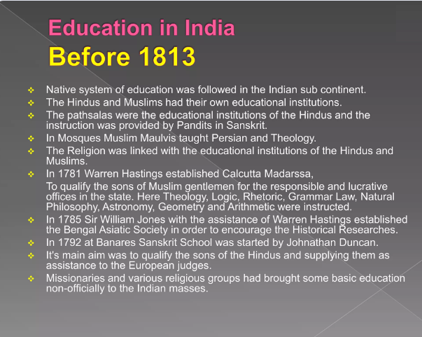

Slide 3
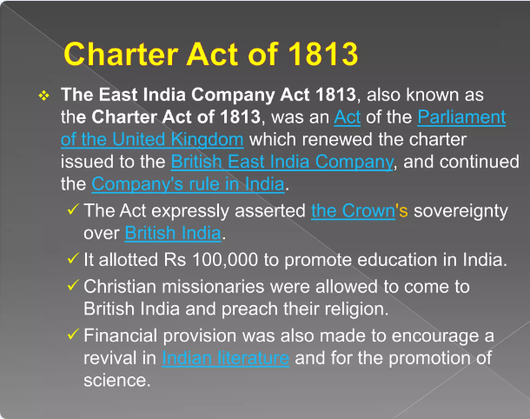

Slide 4
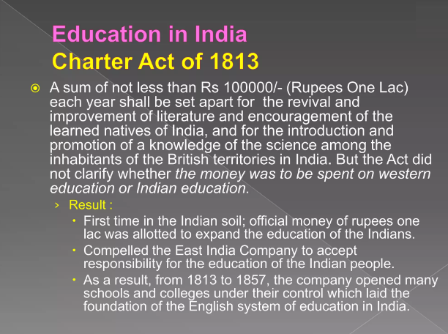

Slide 5
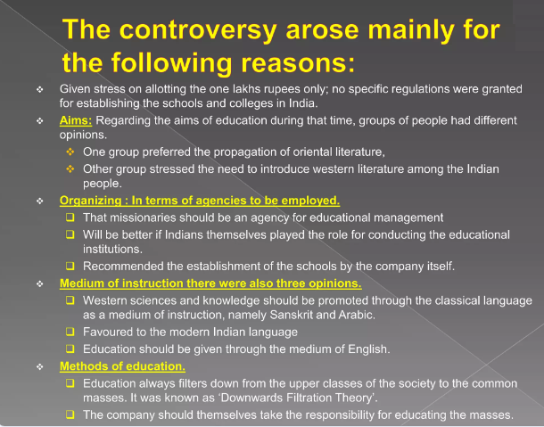

Slide 6
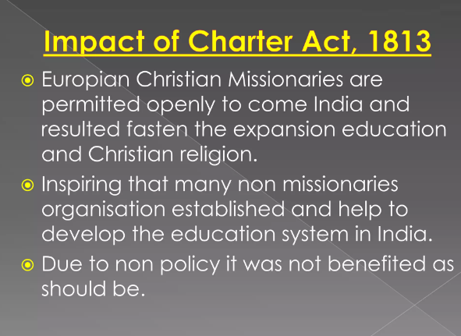

Slide 7
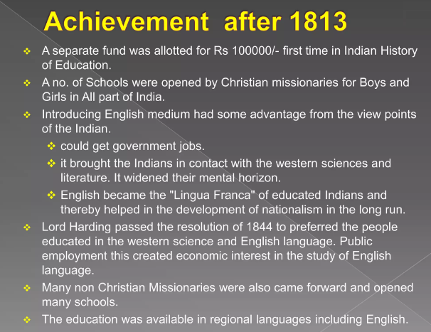

Slide 8
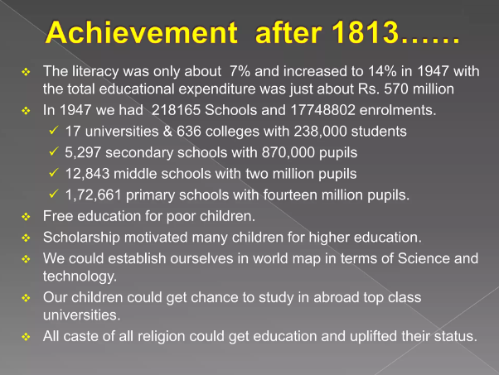

Slide 9
